Slide 1
UC Schedule App
By
Matthew Scurry
Arthur Johnson

Slide 2
Application Overview
In a Nutshell: takes your schedule from the UC database and adds it to your phone calendar.
Events are able to be modified to fit in hw due dates, exam, etc.
System Metaphor: Agenda

Slide 3
Application Overview
Uses UC Scheduling API and Calendar API
The user needs to login using their UC credentials.
The user can then view their schedule and download it to there phone.
The user will get their schedule on their phone calendar without any prompts.

Slide 4
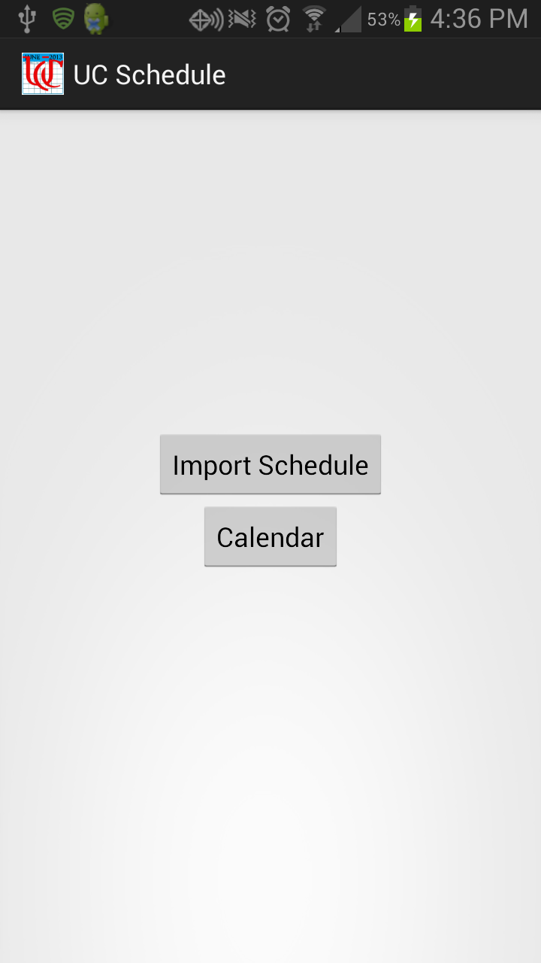
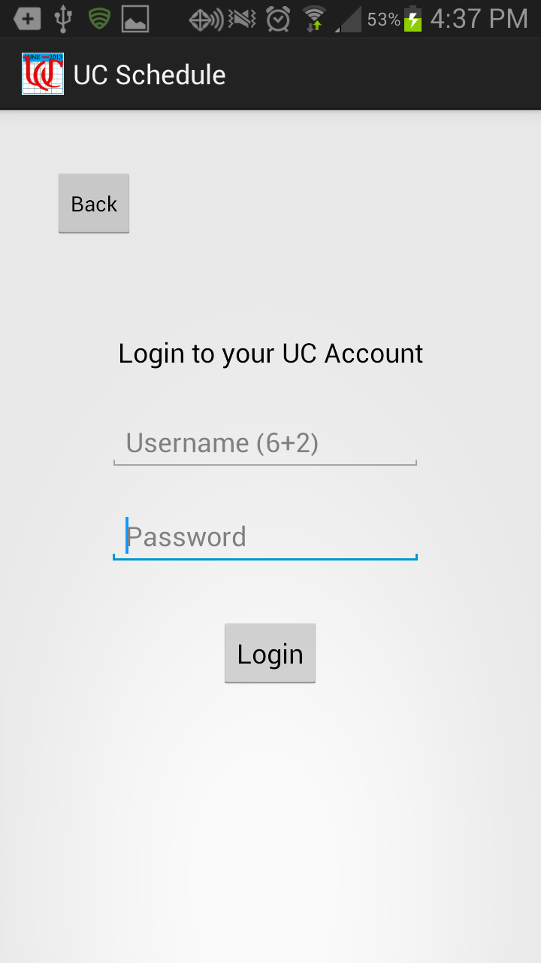
Example UI

Slide 5
Why make this app?
A portable version of the UC schedule (no paper)
You don’t always have internet access (a local copy wouldn’t be a bad thing)
The current mobile schedule viewer sucks
Contains room for notes and what not.

Slide 6
Functional Requirements
User needs to log in with proper UC credentials
User needs to be able to confirm online schedule before adding
Events need to be added with a notification when everything is completed
User needs to be able to update schedule

Slide 7
Non-Functional Requirements
Application needs to perform smoothly (non-specific requirements yet)
Text and color need to be the same on each page.
Calendar needs to account for the user updating the event(not overriding user changes)
Simple UI

Slide 8
What we have accomplished
A basic GUI for the login page has been implemented
The calendar can be opened within the app
Events can be added without any user prompting
Test cases for Add Event have been implemented.

Slide 9
Future Plans
With the UC Scheduling API, we plan to test the login credentials using a test account
Once that is done, we will try to sort the schedule into events that we can put on the calendar and… put them on the calendar
After that, we will try to add custom fields to make it easy for the user to input data.
Test in between each phase.

Slide 10
Big Milestones
GUI created (completed)
Calendar in app (completed)
Add event to calendar without intent (completed)
Login to UC
Download schedule
Add custom fields

Slide 11
Projected Timeline
May 28 2013: added Basic GUI
June 11: added phone calendar in app
June 25: Able to Add Event without user prompting
Early July: User is able to login using UC credentials
Mid July: User is able to download their schedule into their phone
Late Mid July: User is able to edit events using custom fields

Slide 12
Test Plan
Think of everything that could possibly go wrong in a feature our app (because more times than not it will go wrong) and write a test case for it.
Once the code is implemented for that feature, test all of the test cases and make sure that they are handled properly (so the app doesn’t crash)

Slide 13
Test Cases
Add Event
1 | Precondition: app is trying to add an event with startDay > 28 when startMonth = 2 and startYear is not (divisible by 400) nor (divisible by 4 and not by 100) | The event was not able to be added | The event was not able to be added. An exception was thrown to prompt the user of this failure.

Slide 14
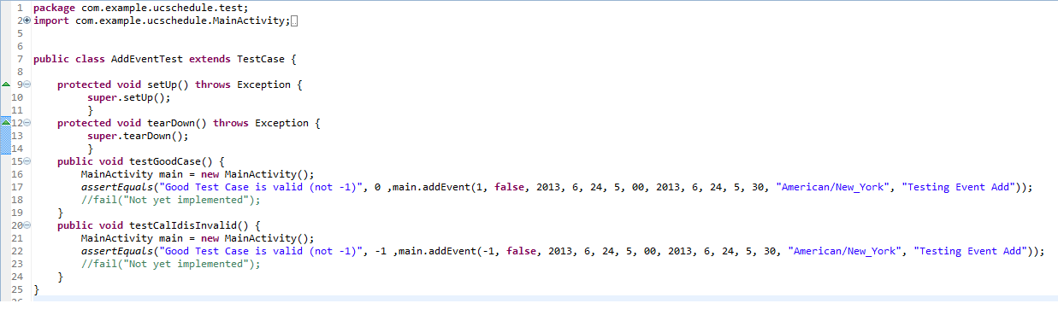
Example Unit Test

Slide 15
Calendar API Functionality
The calendar API allows the programmer to create a calendar or modify an existing calendar.
The API can be used to add events, edit events, delete events, add notifications, etc.

Slide 16
Easy Way: Using an intent
This will pull up a window with all of the users’ event data inside the default add event intent.
Pros:
It’s very easy to code
Easy to get info from the user
Cons:
The user needs to do this for every event they add
This is very slow and very annoying

Slide 17
Hard way: Hard Coding
The official calendar API was created on Android 4.0.
Uses a content provider to access the calendar data.
Contains several URI’s that link to the CalendarContract.
CalendarContract contains stored calendar data in tables.

Slide 18
Hard Way: Query
There can be several calendars on a device (e.g. one for each account).
A Content Resolver is used to query a calendar.
The query returns a cursor object which is used to traverse through the tables of that calendar.

Slide 19
Hard Way: Modifying a Calendar
Every calendar and event has an ID.
Events table contains several constants that contain information about the event (e.g. title, time, location).
ContentValues is contains the information you want to modify.
A ContentResolver is used to modify the calendar.

Slide 20
Hard way: Sync Adapters
Sync Adaptors are used to sync data between a server or data source and the user’s calendar.
Used in the same way as an application but also requires querying the accounts on device.

Slide 21
Hard Way: Pros and Cons
Pros:
Events can be added to the calendar directly.
More customizability.
Cons:
More complex.
The API was recently created on Android 4.0 (Ice Cream Sandwich).

Slide 22
Composite Design Pattern
Also known as: Tree Design
Motivation: When dealing with a tree structure, it is at times difficult to determine what is a branch and what is a leaf(or node).
Intent: Organize objects into tree structures. This allows objects and compositions of objects to be treated the same.

Slide 23
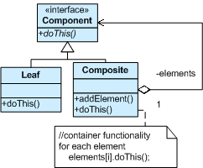
Composite pt.2
Classification: Structural
Structure and Implementation:
Compose objects into tree structure
Relationships are hierarchical
Be able to manage child nodes (default commands in tree structure).

Slide 24
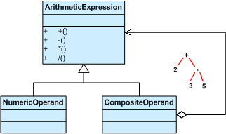
Composite pt.3
Applicability: Calculator app that must abide by the order of operations or anything that contains a priority

Slide 25
Composite pt.4
Participants: Leaf, Composite, Component
Related Patterns:
Decorator Pattern: Decorators and Composites will usually share a common parent class. The Decorators support the Composite with functions such as getChild, addChild and removeChild.
Consequences:
Makes it easier to add new kinds of components.
Simplifies Clients.
Harder to restrict the type of components of a composite.

